Slide 1
CHAPTER 11
Prefix sum (scan)
An introduction to work efficiency
in parallel algorithms

Slide 2


Slide 3
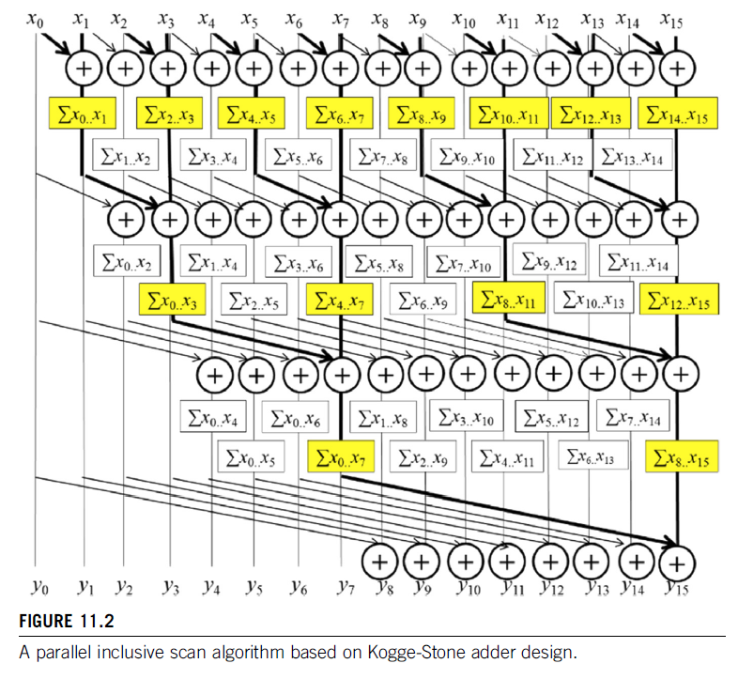

Slide 4
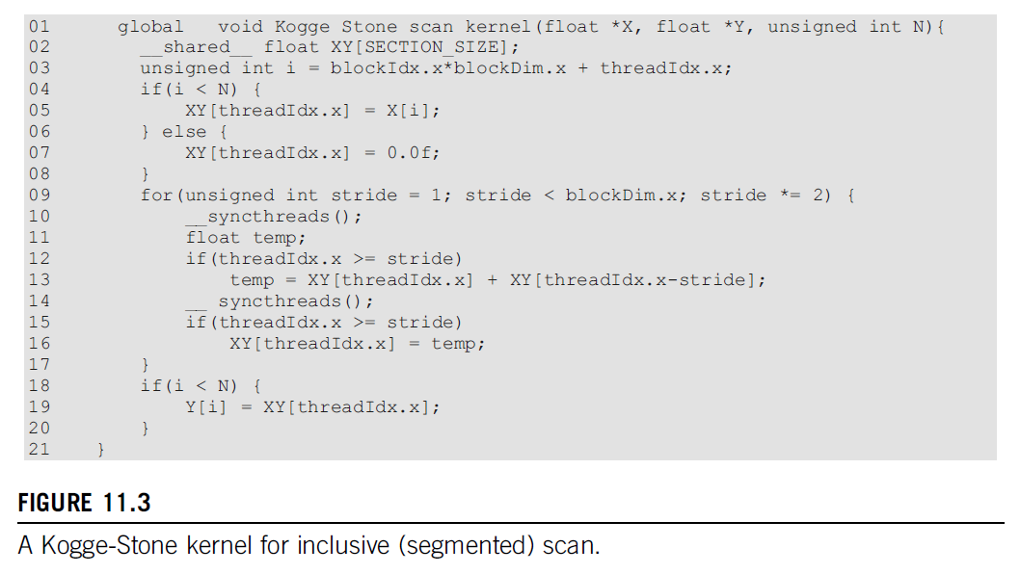

Slide 5
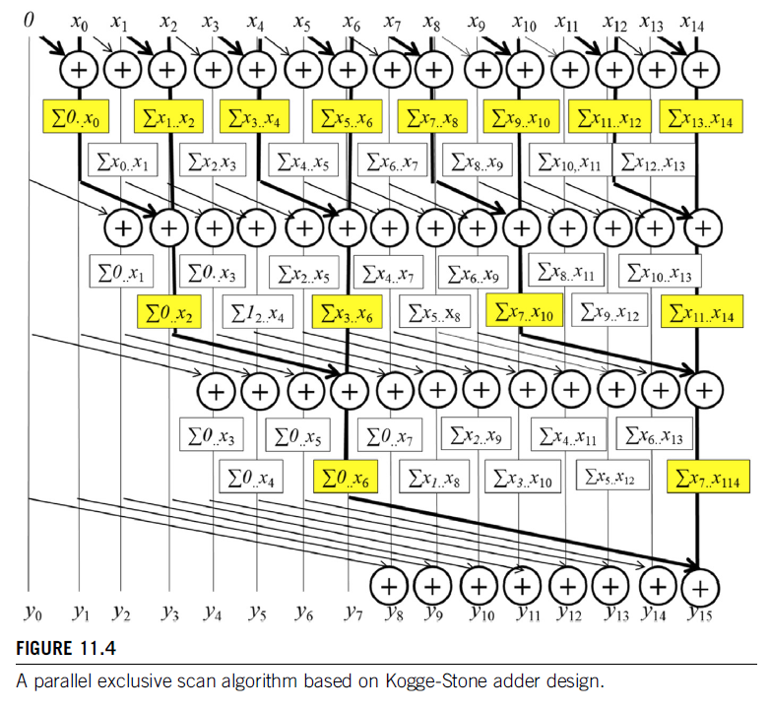

Slide 6
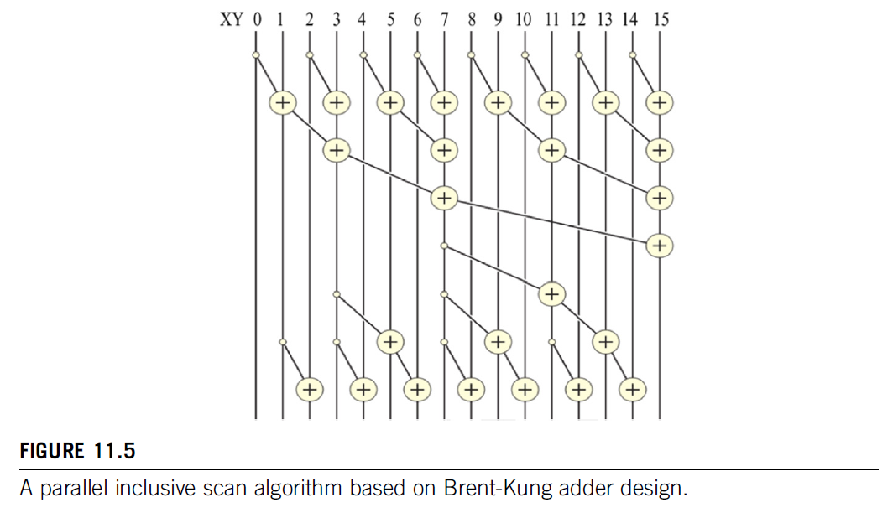

Slide 7
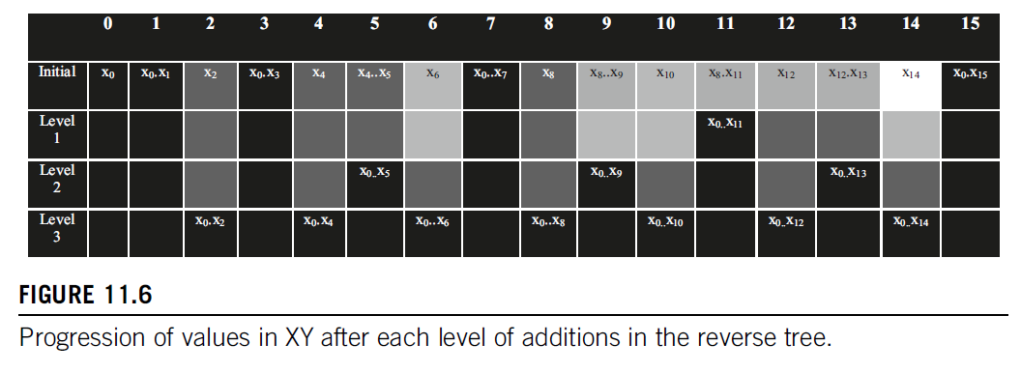

Slide 8
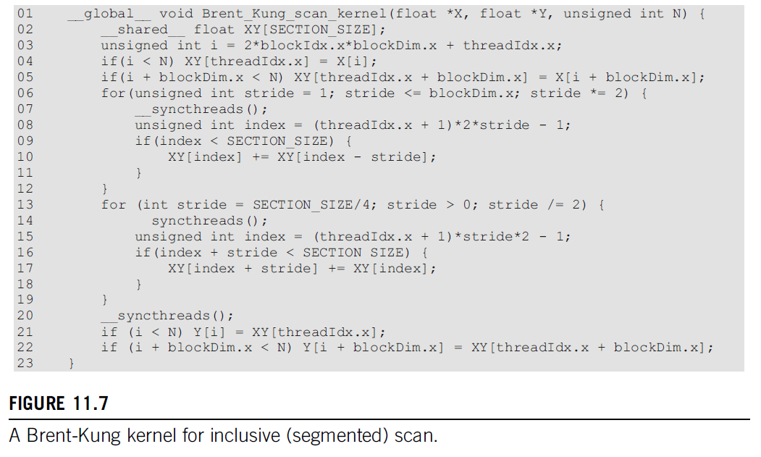

Slide 9
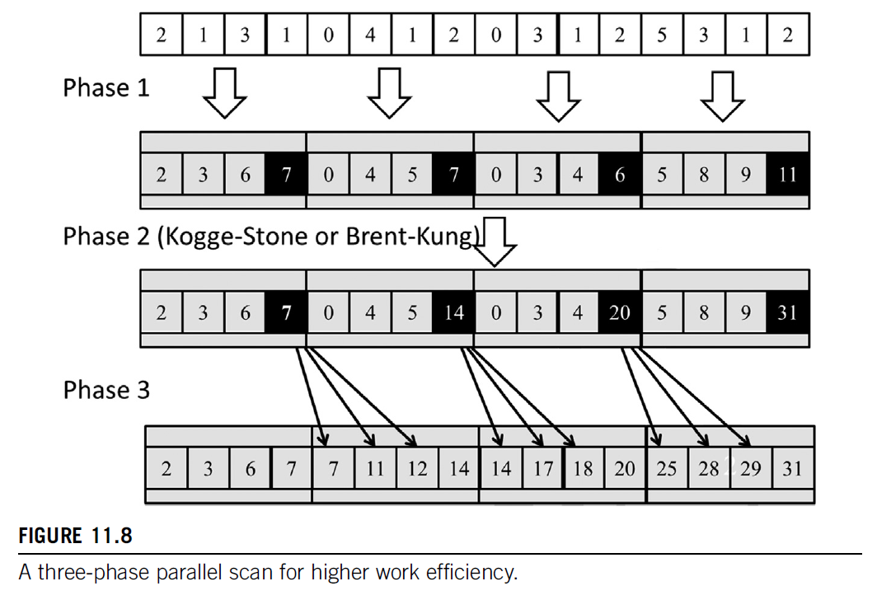

Slide 10
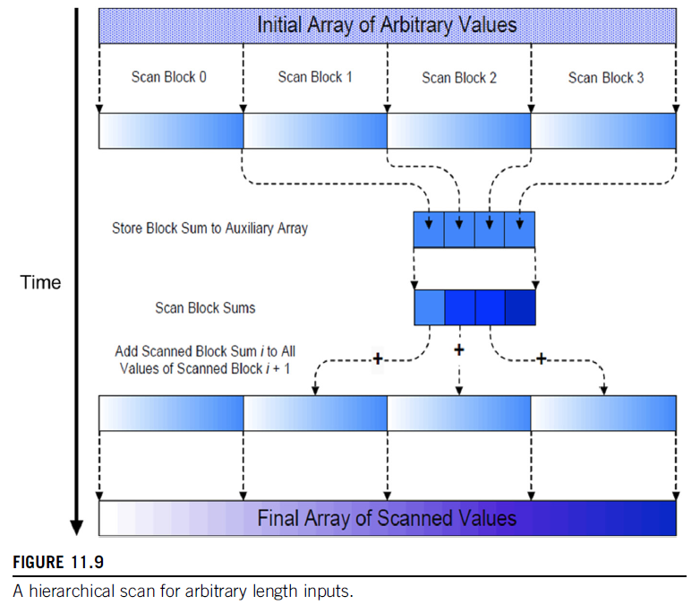

Slide 11
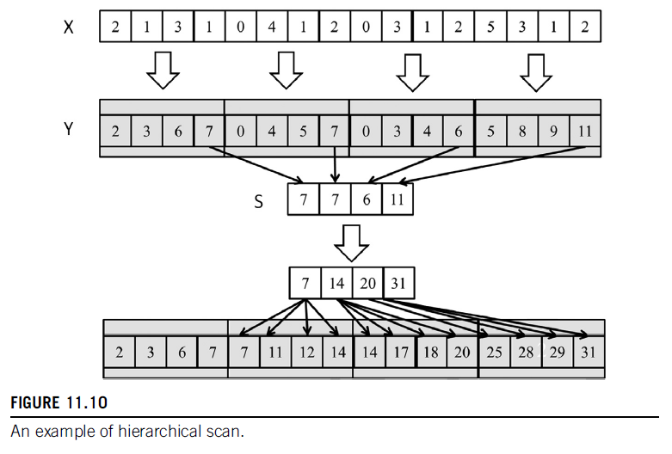

Slide 12
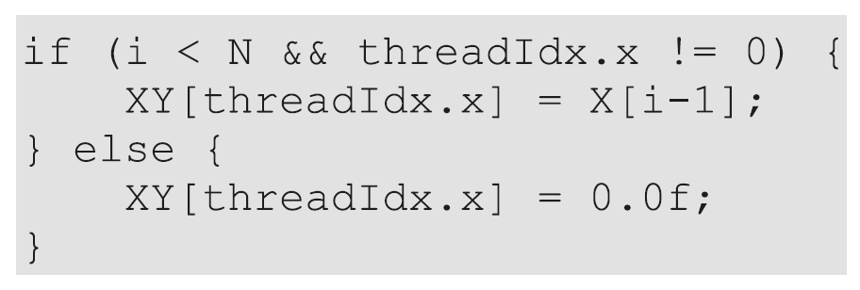
In-text figure 1

Slide 13

In-text figure 2

Slide 14

In-text figure 3

Slide 15

In-text figure 4

Slide 16

In-text figure 5

Slide 17

In-text figure 6

Slide 18
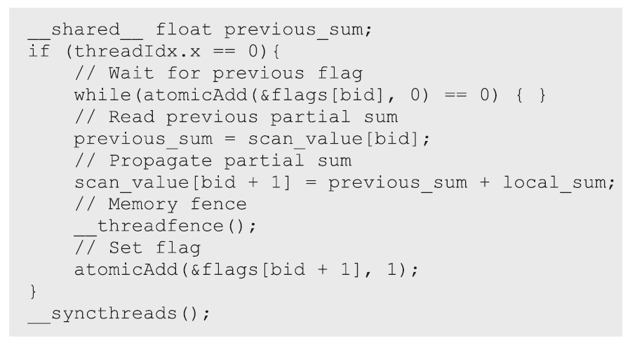
In-text figure 7

Slide 19

In-text figure 8

